Slide 1
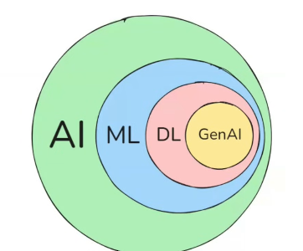

π
Loss/Cost Function Neural Network
Time Series Data
ANN,CNN,RNN
Loss /Cost Function
ANN
Mean Squared Error Fn
RNN
Notes:
Content: https://www.linkedin.com/pulse/chunking-strategies-ai-data-kash-kashyap-0lghe/

Slide 2
Cost fn/Loss function
"minimize the cost function" means reducing the error between the model’s prediction and the actual result.
🔍 Analogy:
Imagine you're doing archery.
The bullseye = correct answer
Your arrow = model’s prediction
Distance between them = error (cost) Minimizing the cost function means adjusting your aim so the arrow hits the bullseye every time.
The main purpose of cost and loss function is to minimize the error

Slide 3
Linear Regression (find out relation bet x(independent) and y(dependent) ) but how ,by ploting a line that line is called best fit line
The cost function says: “Alright, you have drawn a line for linear regression. But is your line perfectly correct? Is it guaranteed that your line has no error? Is it certain that your model’s predictions have no error?”
Your accuracy is being 100% might not be possible. It’s not necessary that you always get 100%.
So, the cost function tells you: “Whatever error has been introduced in your modeling, in your best‑fitting line, I will measure it. That’s my job.”
In other words, the cost function says: “I will measure the difference — the error — between the predicted value (the one your model gives) and the actual value (the ground truth).”

Slide 4
the cost is the error in out predicted value. We will use the means Square Error function o calculate the cost
Measured value( Yi)
Error
1
2
3
4
5
6
7
8
Predicted Value ( y predicted)

Slide 5
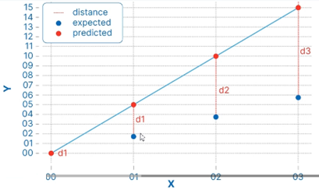
We will use the Mean Squared Error function to calculate the loss. There are three steps in this function:
Find the difference between the actual y and predicted y value (y= mx + c), for a given x
Square this difference
find the means of squares for every value in X
Actual values- predicted values=Y-Y'
Where Y=Actual Value
Y'=Predicted value

Slide 6


Similarly ,We have to find this cost function for all data points, then we can write like this:
Cost function0(d0)=Y0-Y0'
Cost function1(d1)=Y1-Y1'
Cost function2(d2)=Y2-Y2'
Cost function3(d3)=Y3-Y3'
………………………………………
……………………………………….
Cost function n( dn)=Yn-Yn'
Mean Squared Error Cost function equation
Here Yi is the actual value and Y^i is the predicted value, lets substitute the value of Y^i:
So we square the error and find the mean, hence the name Mean Squared Error. Now that we have defined the loss function, lets get into in the interesting part- minimizing it and find m and c by Gradient Descent

Slide 7
➡
The objective is to learn the values of parameters (aka feature weights) that minimize the cost function.
➡
Most widely used optimization technique to minimize the loss is called the Gradient Descent.
Cost function↑
Model accuracy↓
Cost function↓
Model accuracy↑

Slide 8

🔍 Technical Angle
Let’s assume we’re doing a simple regression:
This is called Mean Squared Error (MSE).
If the difference between the prediction and the actual value is large → the cost will be high.
If the prediction is close to the actual value → the cost will be low.
The goal of training is to bring this cost down to the minimum possible value.

Slide 9
🚀 How do we minimize it?
We use optimization techniques like Gradient Descent.
The model’s parameters (such as weights and biases) are adjusted step by step so that the cost function gradually decreases.

Slide 10
🚀 Loss Function Type
Mean Absolute Error (MAE)
Mean Squared Error (MSE)

